Slide 1
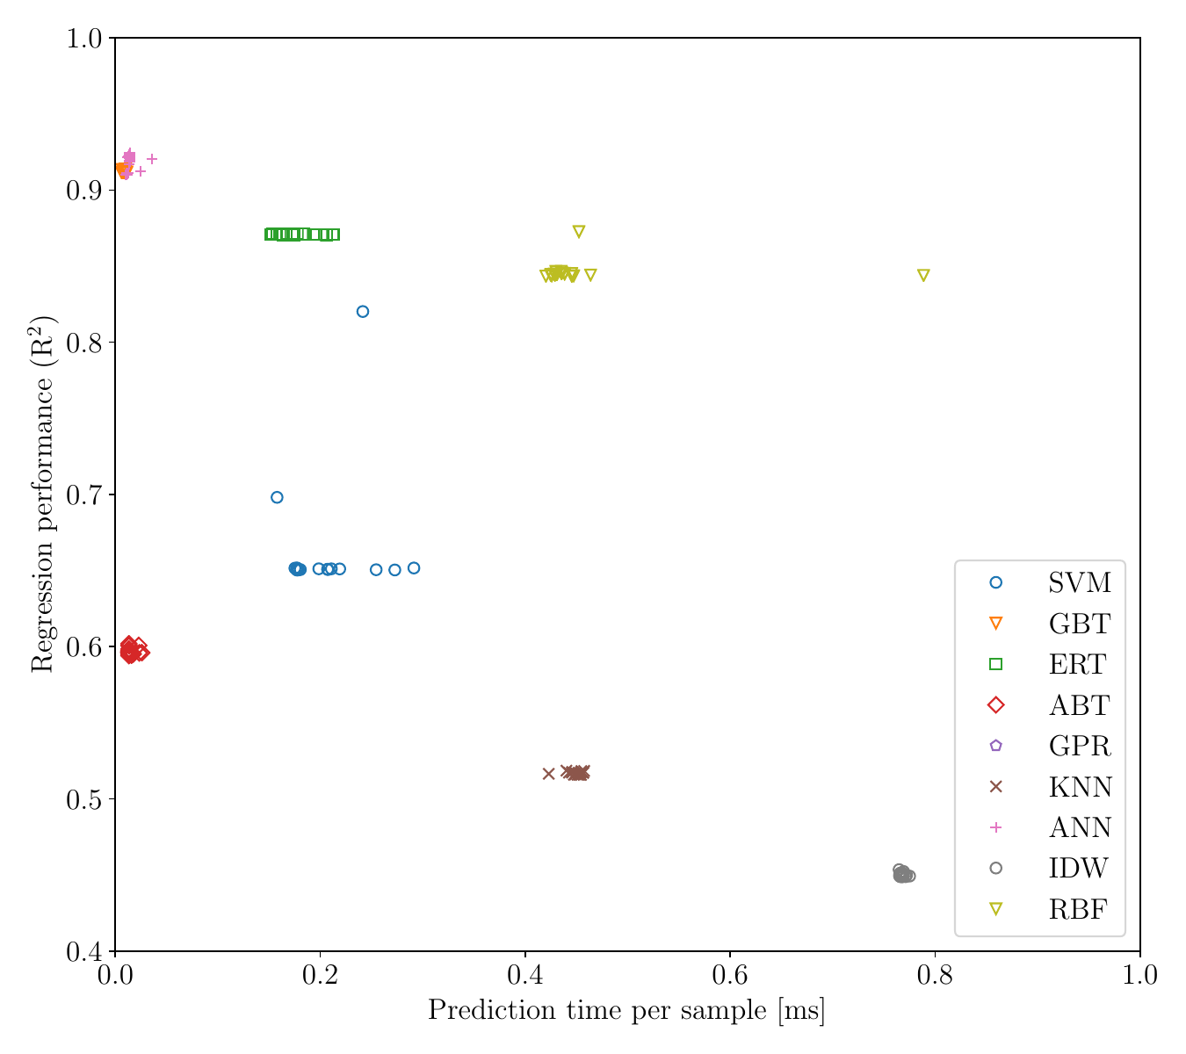
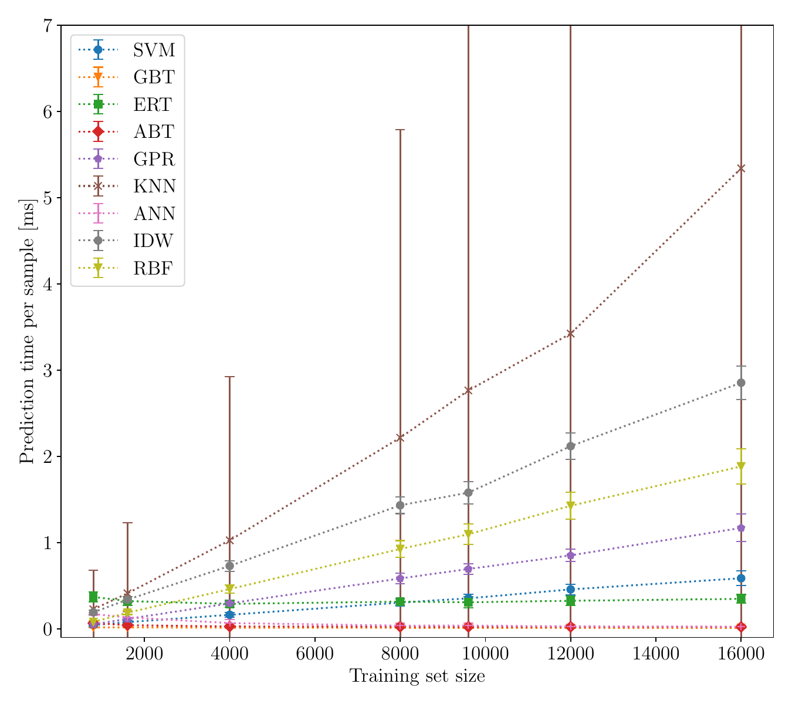
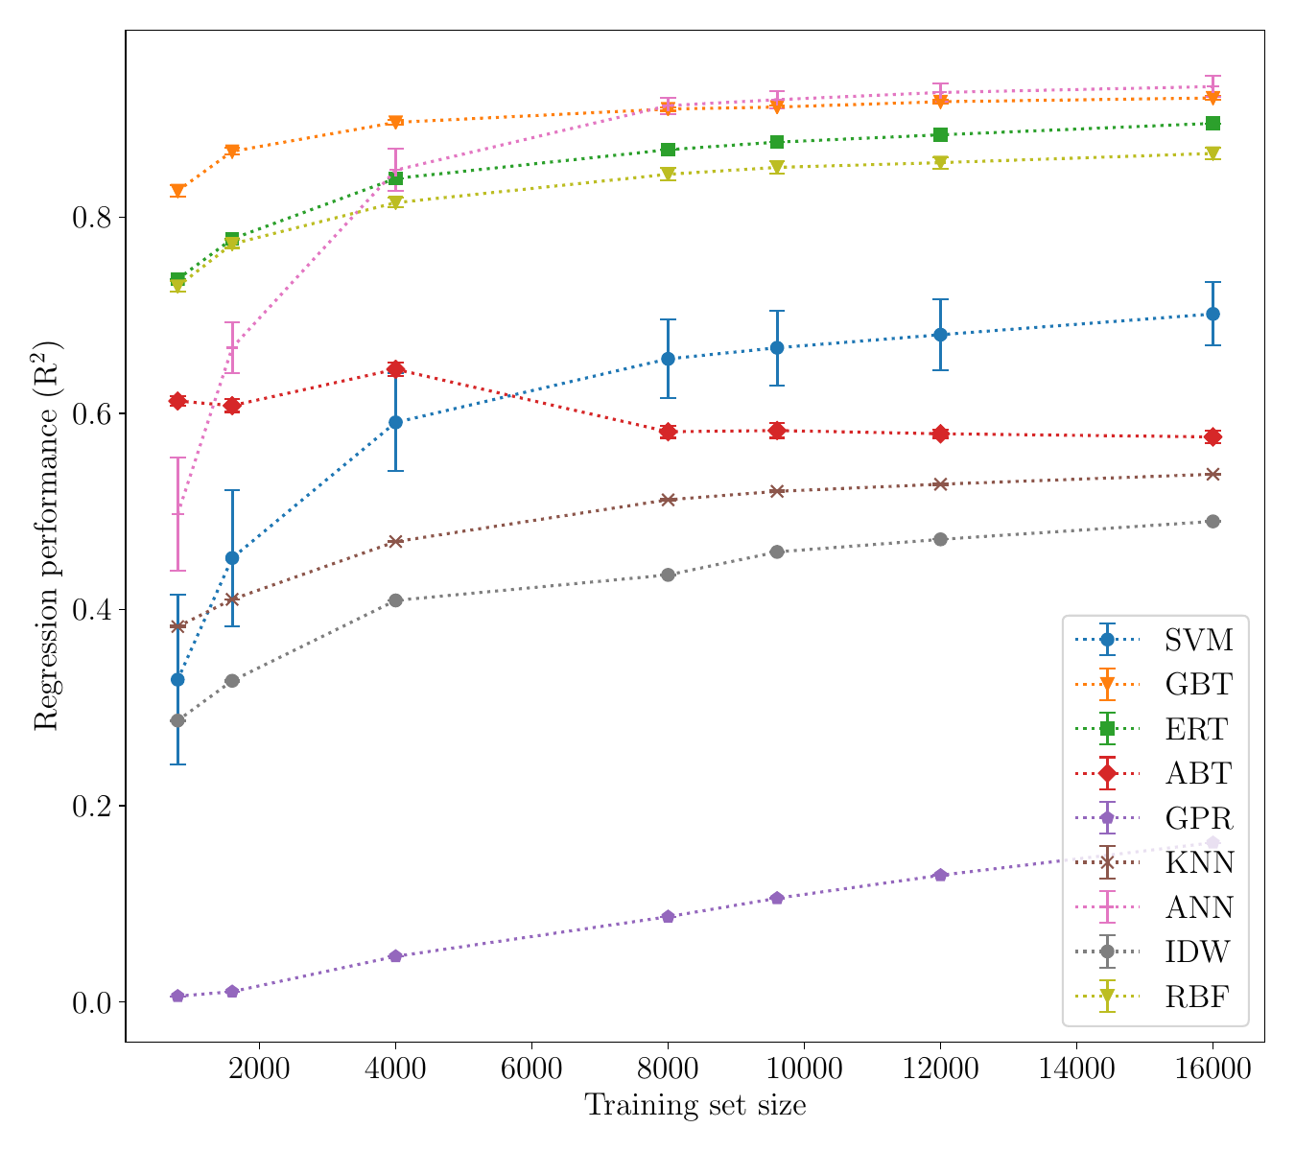
Surrogate modelling of TBR: Methodology
A decoupled approach:
Generated 900K samples from OpenMC simulation (using simplified spherical model).
Trained & reviewed a diverse set of surrogate families in a 5-fold cross-validation setting.
Metrics of interest:
Regression performance (as coefficient of determination, R²),
Prediction time per sample (measured as wall time).
How many datapoints are needed for learning a sufficiently accurate surrogate?
The best & fastest approximators
The 20 best-performing hyperparameter configurations per each surrogate family.
Prediction time per sample [ms]
Regression performance (R²)

Slide 2
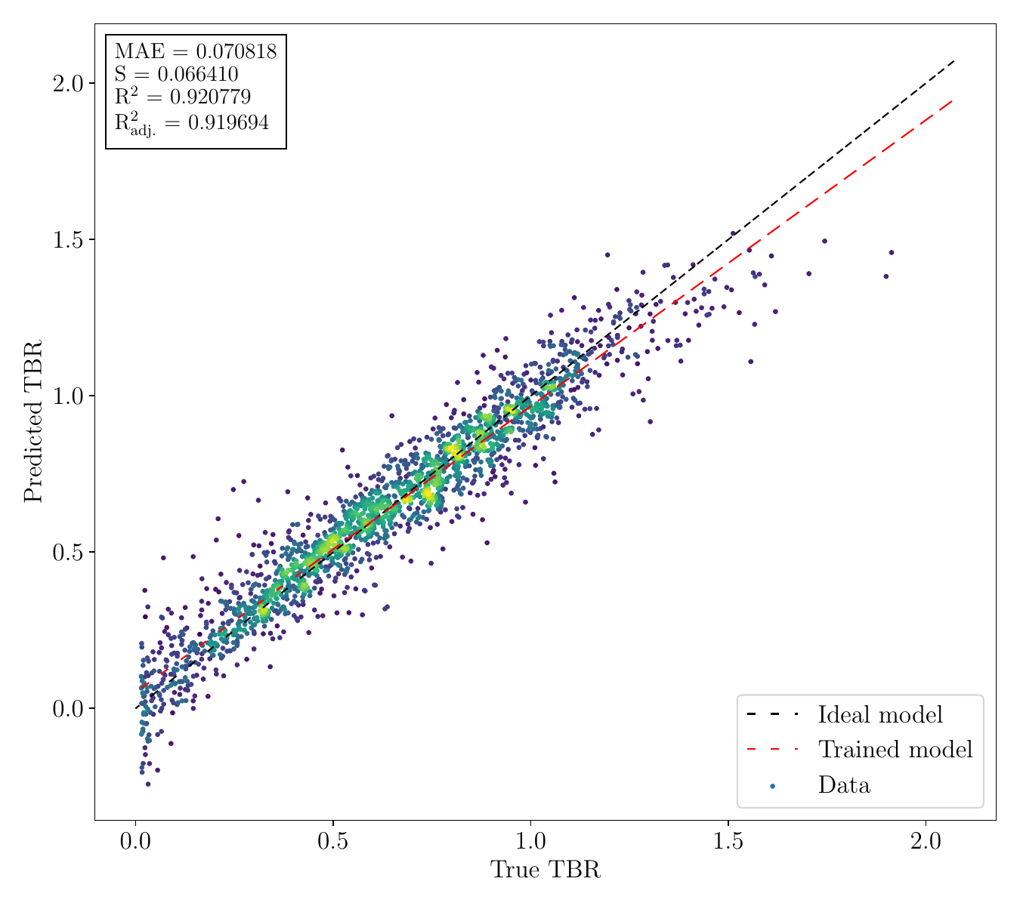
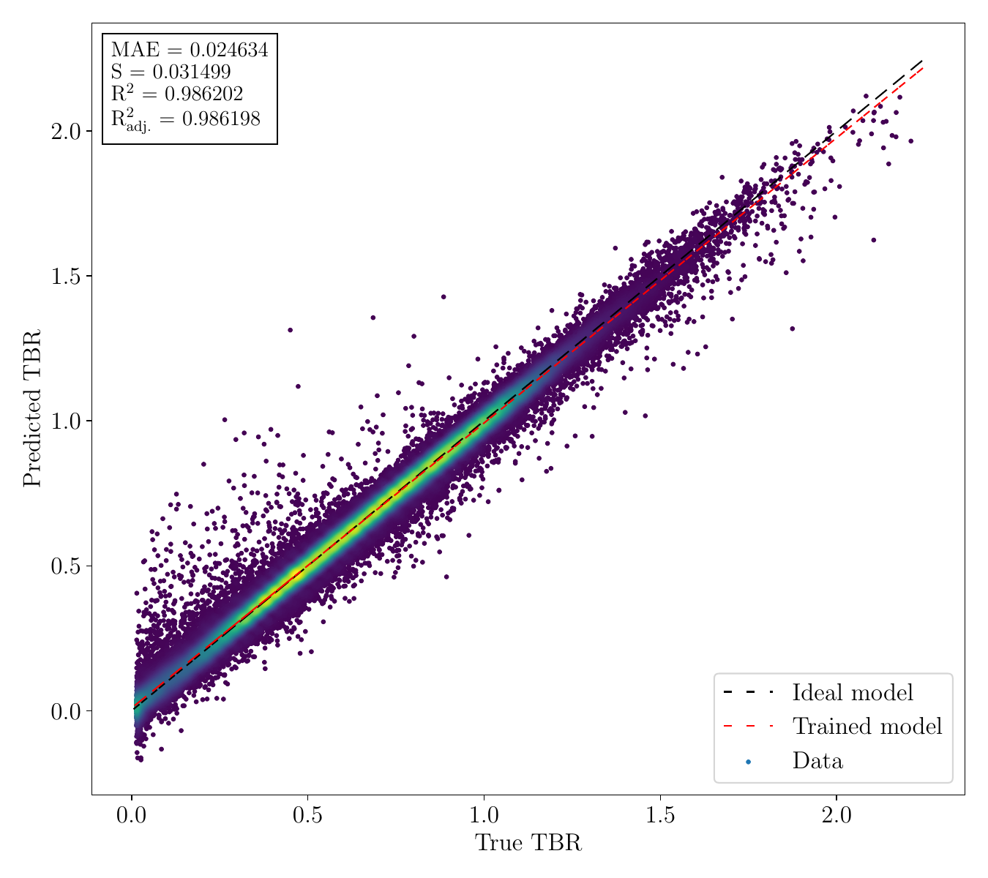
Surrogate modelling of TBR: Results
2 clear winners: decision trees (gradient boosted, extremely randomised) and dense neural networks.
Both are fast: observed relative speedups of order 10⁶ w.r.t. multi-threaded TBR MC (on 40 CPUs)
A proposed heuristic depending on amount of training data available:
Small dataset (or has yet to be obtained) → DTs provide satisfactory approximation early on in training with as little as ~10K points.
Data available in large quantities (~100K+ points) → DNNs overall scale better in R², offer constant prediction time.
GBT, 10K training samples
Rel. speedup: 1,269,777x
DNN, 500K training samples
Rel. speedup: 8,659,251x

